Slide 1

CO2 Czech Solution Group, z.s.
Ing. Leoš Gál
mobil: 736 50 50 12
15.12. 2021

Slide 2
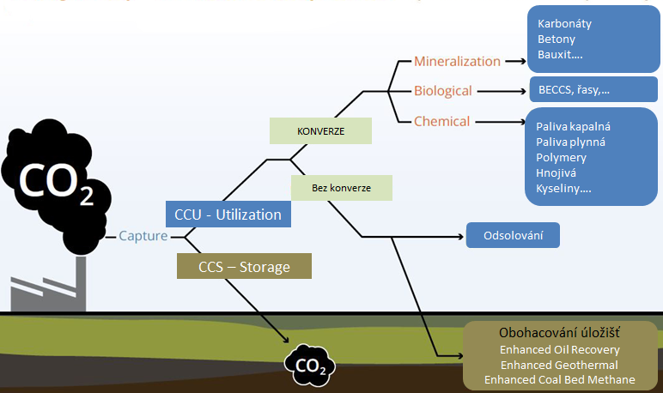
CO₂ from industrial production and processes CCS, CCU
Priorita 1
Carbonates
Concretes
Bauxite..
BioCCS , algae
Liquid fuels
Gas fuels
Polymers
Fertilizers
Acids …
Conversion
No Conversion
Priorita 2
Desalination NaHCO₃
Priorita 3

Slide 3
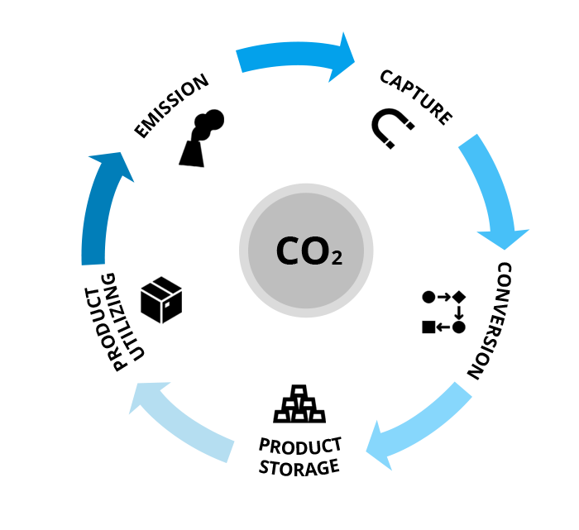
CO₂ from industrial production and processes CCS, CCU
CCU - It will not just be a bridging technology in CO2 mitigation, but goes much further by enabling closed carbon cycles.
It offers the chance to produce carbon-based products using renewable energy, enabling the defossilisation of industries.

Slide 4
Basic objectives of the association - CCS and CCU
PRIMARY Establish action expert groups (industrial and scientific potential)
SECONDARY Involvement of the Czech Republic in international cooperation
low-carbon and circular economy
TERTIAL To create an effective cooperative environment in the Czech
Republic (R&D - science-science) – industry - government

Slide 5
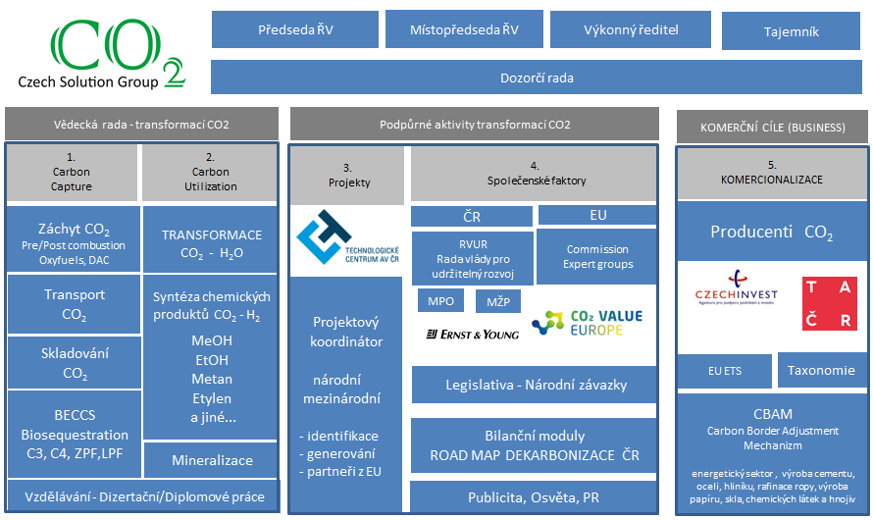

Working structure of the association

Slide 6
Working structure of the association
Ojectives of the Scientific Council

Slide 7
Scientific Council - CO2 transformation
1. R&D Czech Republic for development of own technologies
2. Assessment of commercially available, high TRL technologies
3. Analysis - applicability in the Czech Republic
type and kind of technology - dimensions - potentials - localization - feasibility - LCA
4. Working meetings/workshops on commercially offered technologies or developments
5. Formulation and initiation of own appropriate challenges by Czech entities.
Closer cooperation with industry (CO2 emitters). Transfer of research into practice.
Goal: - Pre-preparation of commercial applications in the Czech Republic
- Linking Czech R&D to advanced R&D and Czech industry
- Projects initiated by industry

Slide 8
Working structure of the association
Support activities

Slide 9
Support activities
1. Map of Czech R&D entities with potential for effective involvement in CO2 research
who - where - what they have done - potential (technological, professional)
2. Analysis of EU CO2 challenges
Identification of suitable Czech entities with the potential to participate in projects
3. Within the Czech Republic - Close cooperation with relevant entities and Government
4. Within the EU - Cooperation with competent EU experts : CO2 Value Europe Association
5. ROAD MAP de-carbonisation – Inventory of production and Czech bio-sequestration by photosynthesis
6. Publication and awareness-raising activities, Public Relation
GOALS:
Systematic activation of Czech R&D potential in all areas of CO2
Cooperation of entities (chemistry, nano-technology, microbiology, landscape, soil...)
Involvement of Czech R&D in international cooperation
Faster and more flexible response of the Czech industry to EU directives
Saving of Czech resources (disproportion between the use of national and EU resources, the Czech Republic is significantly behind)
Connectivity of the expert sphere and the state administration (legislation, obligations,...)
PILOT PROJECTS

Slide 10
Working structure of the association
Business

Slide 11
COMMERCIAL OBJECTIVES (BUSINESS)
The main focus: To apply B.A.T. to de-carbonisation processes in the Czech Republic
1. ANALYSIS
- Develop an information database of suitable commercial technologies for de-carbonisation processes
- Analyze EU project calls and identify Czech entities with potential for cooperation (scientific and industrial)
2. COOPERATION
Ensure effective cooperation outside the Czech Republic science - CO2 emitters (linking entities, .....)
Czech participation in EU expert bodies
APPLICATIONS
- Facilitate the emergence of DEMO technologies or production processes (by linking science and industry)
- Presentations/ workshops and present the possibilities of technology application in the Czech Republic
- Organize technology presentations (conferences, workshops, visits)
- Offer qualified assessments of the suitability of technologies for specific events in the Czech Republic

Slide 12
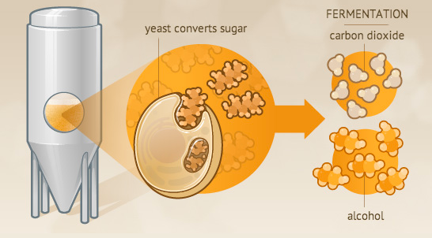
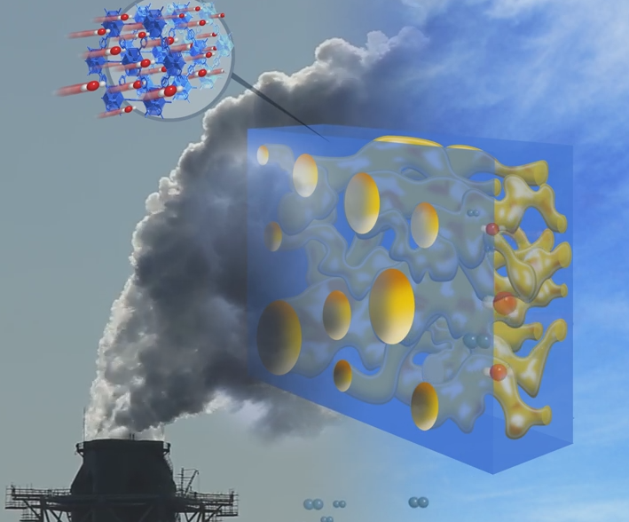
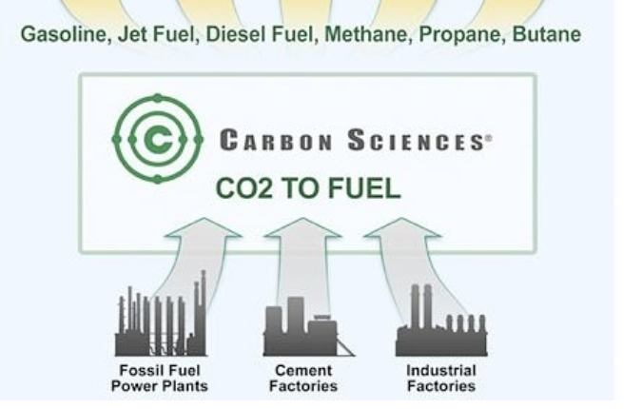

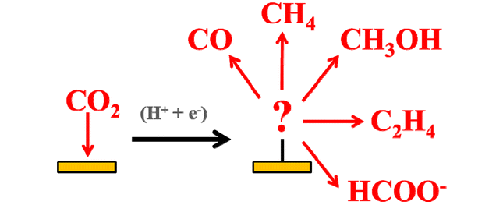

CARBON CAPTURE STORAGE for next following UTILIZATION
1. Phase
2. Phase
The first phase
DEMO
CCS
capture from chimneys
Emitováno | 66 000 000 | tun
EU ETS (€/tunu) | 80 | €/t
Celková hodnota | 5 280 000 000 | €
DEMO
on pure CO2
food quality
ideal for CCSU
Průměr EU – 8,7 t CO₂ ekv./obyv.
Průměr ČR – 12,4 t CO₂ ekv./obyv
https://markets.businessinsider.com/commodities/co2-emissionsrechte

Slide 13
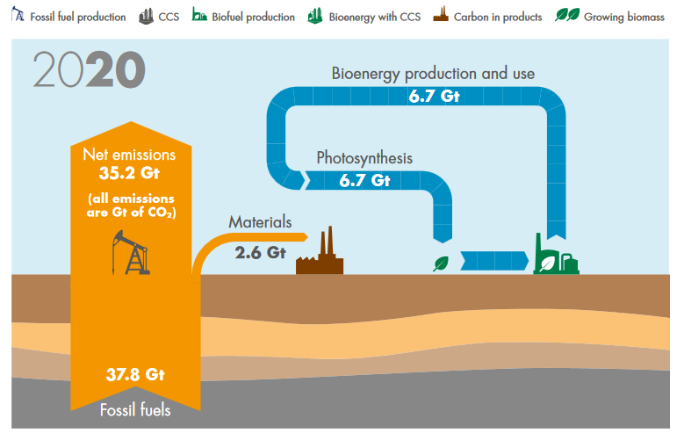
BALANCE OF ENERGY SYSTEM DEVELOPMENT IN CO2 - year 2020
Most of the carbon in the production of energy from fossil fuels is released into the atmosphere, while the CO2 absorbed by the plants used to produce energy is also returned to the atmosphere.
https://www.shell.com/promos/business-customers-promos/download-latest-scenario-sky/_jcr_content.stream/1530643931055/eca19f7fc0d20adbe830d3b0b27bcc9ef72198f5/shell-scenario-sky.pdf

Slide 14
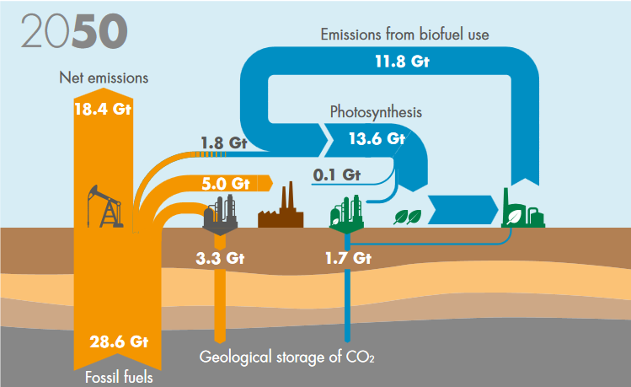
BALANCE OF ENERGY SYSTEM DEVELOPMENT IN CO2 - year 2050
CO2 storage (geological) and CCS/CCSU processes for fossil energy, and CCS for bioenergy BECCS (Bioenergy with carbon capture and storage) are applied
https://www.shell.com/promos/business-customers-promos/download-latest-scenario-sky/_jcr_content.stream/1530643931055/eca19f7fc0d20adbe830d3b0b27bcc9ef72198f5/shell-scenario-sky.pdf

Slide 15
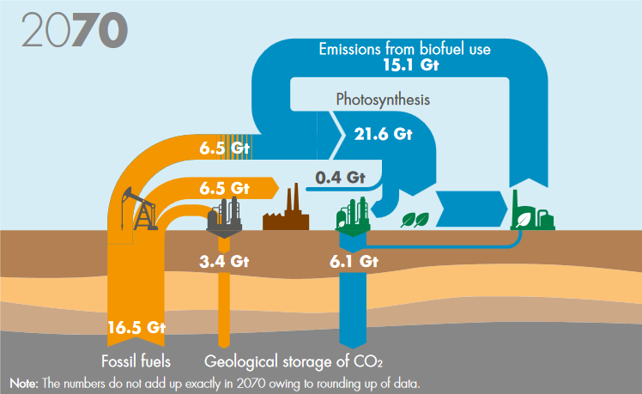
BALANCE OF ENERGY SYSTEM DEVELOPMENT IN CO2 - year 2070
Emission-free energy. Energy from fossil fuels is less than half the cost.
CCS (geological) and CCSU (carbon capture for materials)
Energy from fossil sources is fully offset by captured BECCS.
https://www.shell.com/promos/business-customers-promos/download-latest-scenario-sky/_jcr_content.stream/1530643931055/eca19f7fc0d20adbe830d3b0b27bcc9ef72198f5/shell-scenario-sky.pdf

Slide 16
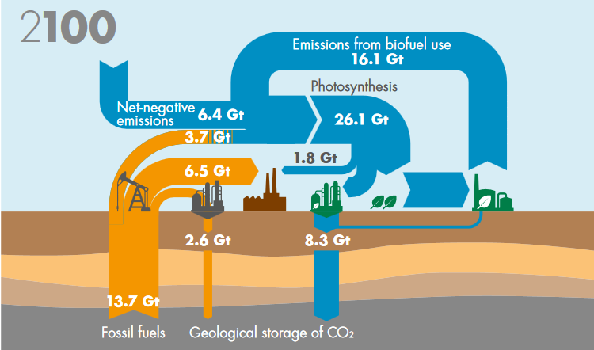
BALANCE OF ENERGY SYSTEM DEVELOPMENT IN CO2 - year 2100
The bioenergy system has reached the limit of its resource base and is twice the size of its resource base. Active CO2 management means that the overall energy system is removing CO2 from the atmosphere.
https://www.shell.com/promos/business-customers-promos/download-latest-scenario-sky/_jcr_content.stream/1530643931055/eca19f7fc0d20adbe830d3b0b27bcc9ef72198f5/shell-scenario-sky.pdf

Slide 17

CO2 Czech Solution Group. z.s.
IČO 11641592
ADRESA:
Rubeška 393/7, Praha 9 – Vysočany, 190 00 Praha
KONTAKTY:
Ing. Leoš Gál
leos.gal@seznam.cz
mobil 00420-736 505012
Ing. Petr Břenek
petr.brenek@pgpt.cz
mobil 00420-775 113349
Ing. Jaroslav Suchý
jaroslav.suchy@pschp.cz
00420-724 809 545

